Slide 2
INTRODUCTION
Online Tour and Travel is a very user friendly project. In this project user can easily understand and book all packages and also register for hotel. In this project there are various types of forms, like all types of packages, book for package and Room Registration Page in which user can insert his personal needs & facilities then upload his form by which user can register in the web site. In this website user can also pay money through credit card.
This site provides different tour packages, hotel booking and summer special tour packages. Through this site, user can book different types of room such as deluxe room, ac room etc on flexible price.
This site provides different packages, destination, and hotel booking services in one particular state of India. Himachal Pradesh is very popular hill station of north India. Visitors enjoy snow covered mountain peaks and adventure sports like trekking, mountaineering and skiing.

Slide 3
ACKNOWLEDGEMENT
I would like to express my gratitude toward staff of MCA as well as the principal of Meerut Institute of Engineering and Technology (M.I.E.T) for providing me a great opportunity to complete a project on Tours and Travels.
My sincere thanks go to Mr. Naushad Imam Sir without his support and guidance for the completion of this project.

Slide 4
PROBLEM DEFINITION
The purpose of tour and travel is mainly to provide online booking services for the user. This statement describes the problem definition of the proposed system. The purpose of this site is to book online ticket for hotels and all tourist places of Himachal Pradesh. The problem definition of the vacation-o-city is to book online ticket for hotel and tourist place where user wants to visit. It is a Web Based Application to develop website in which end user interact with the web-app easily. In this website, Customer or User can search and book all tourist places and all hill stations and all hotels of Himachal Pradesh.
The problem is that we although have many websites but they offer a different kinds of services. The customers are enjoying a lot but there is a lack of relationship between travel agency and customers and hence we are establishing that relationship by carrying and servicing all customers in the same manner that we wish to serve.

Slide 5
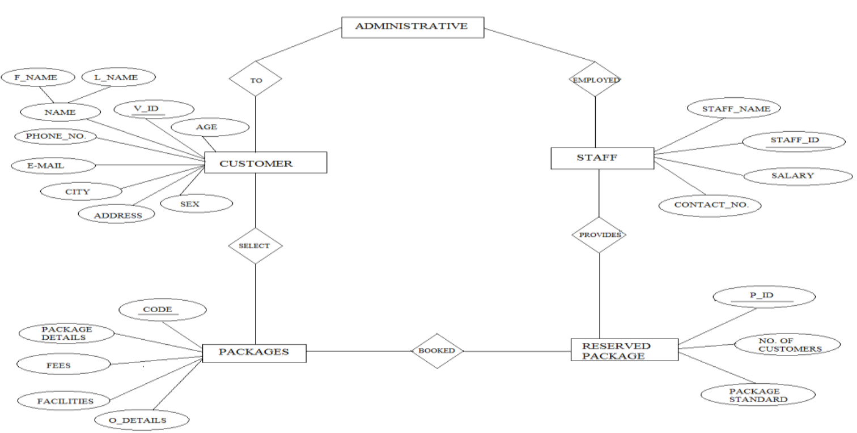
E-R DIAGRAM

Slide 6
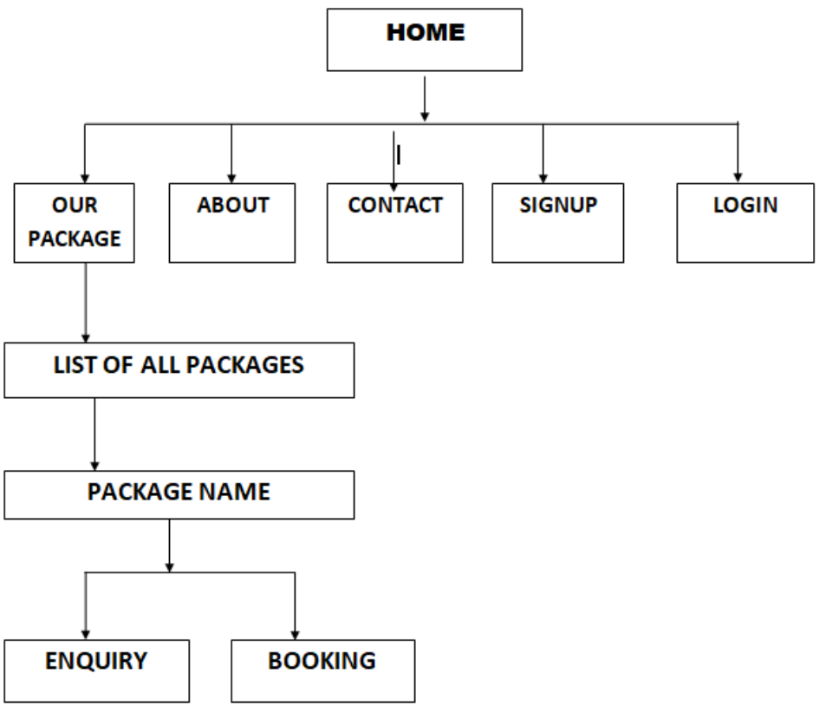
D
A
T
A
-
F
L
O
W

Slide 7
OBJECTIVES
This system provides Online Registration, Tour Package Information, Bus ticket booking and all other destinations. The purpose of this project is very clear that user can find room facilities easily & hotel service providers also get good customers very easily. Customer can register in the website & can create his own registration then he can receive email for his room status related to his reservation and book all packages. User can register hotel for different types of room what they want.
The Main Goal of this project is to provide a very faster room reservation services and also booking services for different types of packages so any user can get this service very easily.
Our objective is to make strong relationship with customers so that they can enjoy the holiday of their dreams.
It saves lots of time , now a days there is a fast process world any one can work quickly so, this project helps that people who are searching for reservation in organization, so they can easily fill up the form and search rooms and different tourist place.

Slide 8
DESIGN
Website Tour and Travel is used to book online ticket for different packages and hotels, adventures and different destinations of Himachal Pradesh. The main page of this website has Home page which contains Register for new account, Login for account.
The user can choose different packages, destinations and hotels from gallery. The user also has the option of changing the password for security purpose and new user must have to create the account to book the packages and hotels. The first option in the navigation drawer is Home, Packages, Hotel, and Destinations (Adventures, Spirituals). Online payment option is also available on this website.

Slide 9
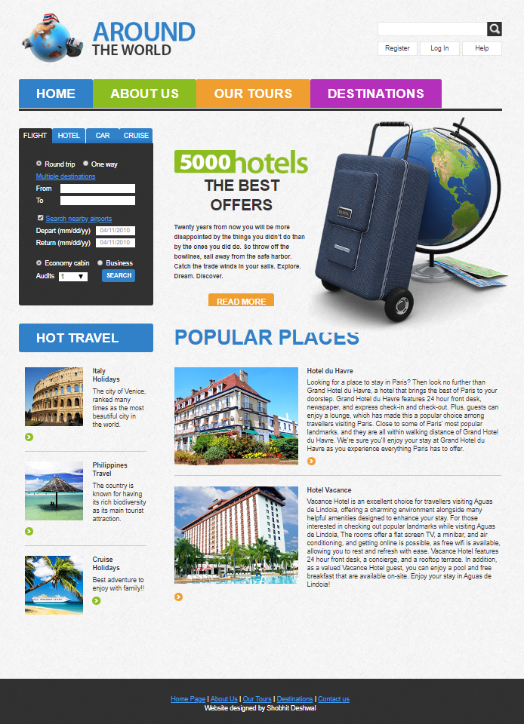
HOME PAGE

Slide 10
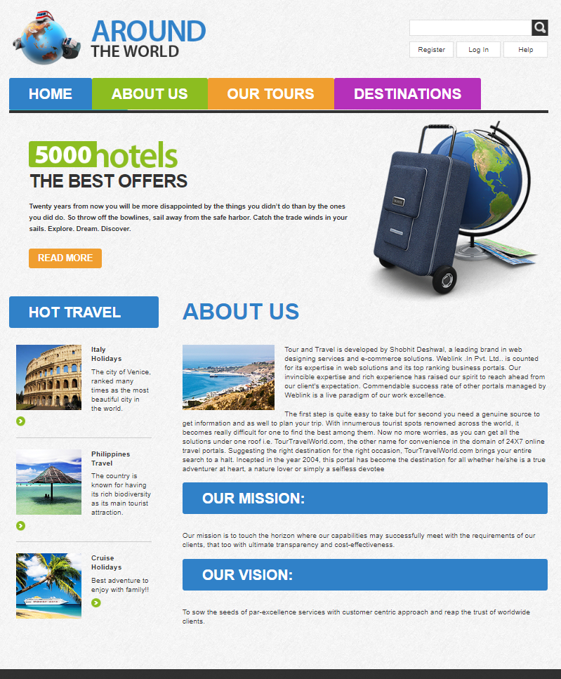
ABOUT-US

Slide 11
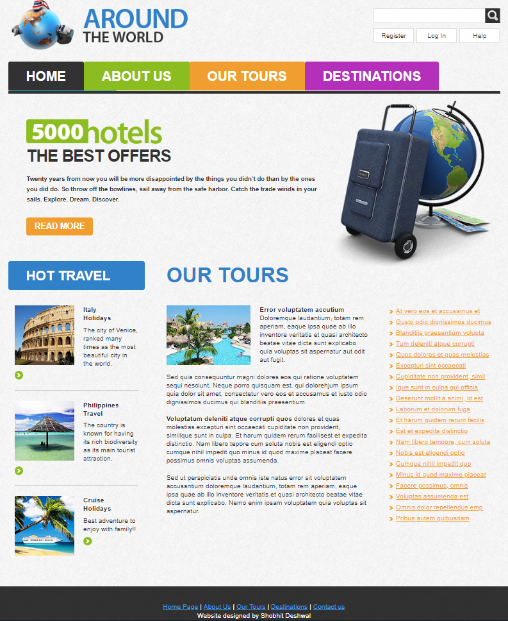
TOURS

Slide 12
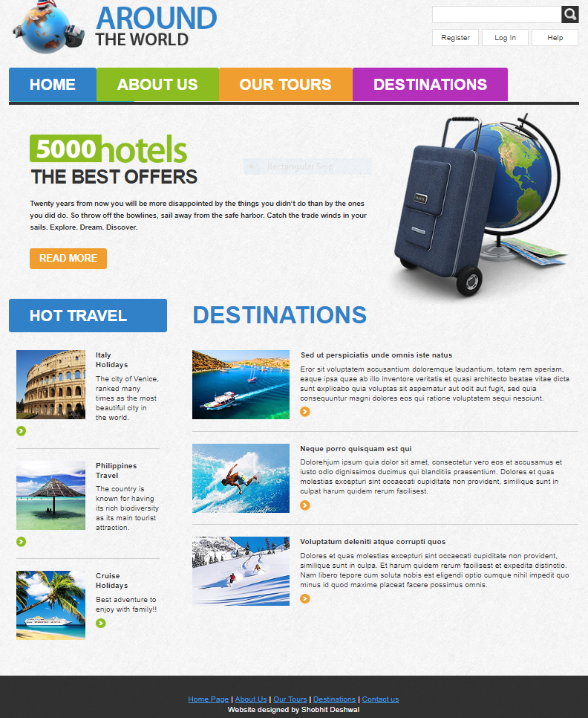
DESTINATION

Slide 13
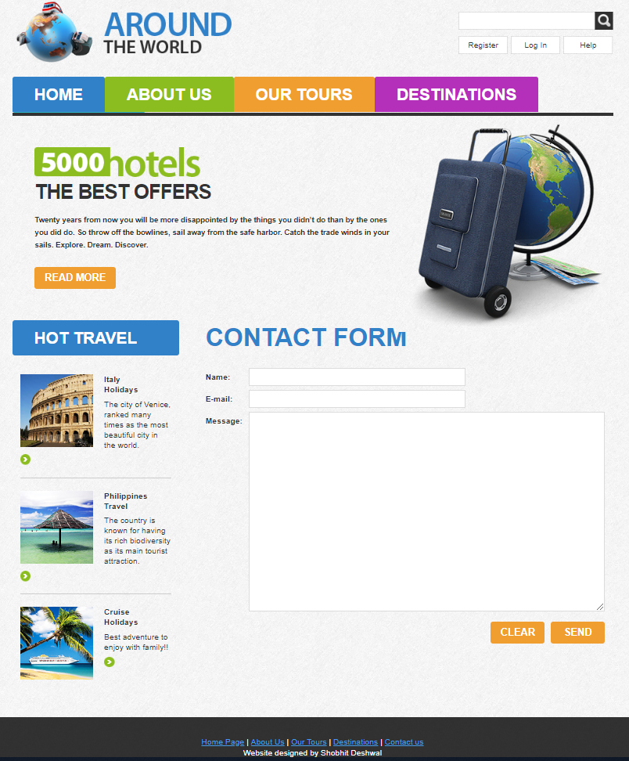
CONTACT

